Slide 1
Assignment 3: Natural Language Processing
Text Classification :
Quora Questions Classification
INFO7390 Advance Data Science
Fall 2023
Presented by
Nainil Maladkar | NUID 002780019
Simran Nagpurkar | NUID 002922747

Slide 2
OUTLINE
Dataset
EDA and Feature Engineering
Text Preprocessing
Bag of Words
Stemming
Vectorization
StopWord Removal
TF IDF Tokenization
Baseline Model Implementation
Logistical Regression
Naïve Bayes
Advance Model Implementation
CNN
DistilBERT Streamlit Application
Results
References

Slide 3
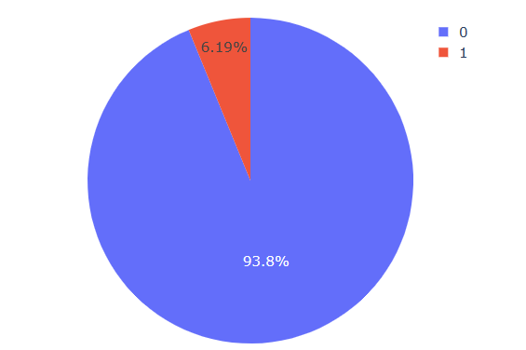
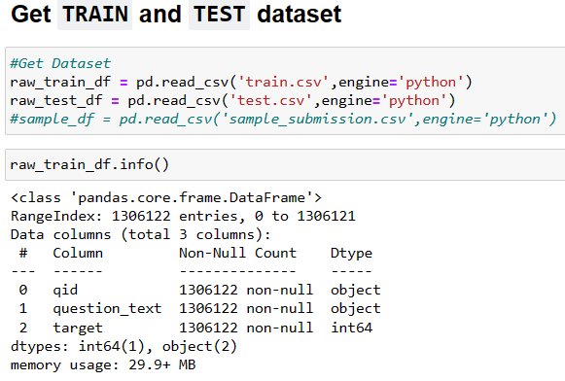
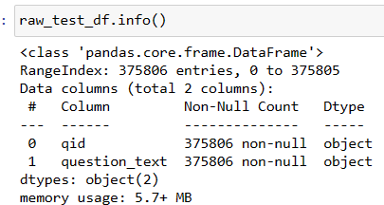
DATASET
Quora Insincere Questions Classification
(https://www.kaggle.com/c/quora-insincere-questions-classification)
Sincere Questions : These are questions that are genuinely seeking helpful answers, contributing to the knowledge-sharing ethos of Quora. Sincere questions are founded on a desire for information, insights, and solutions.
Insincere Questions : Insincere questions are problematic as they are typically not genuine inquiries for information. They may be based on false premises, intended to make statements, or can be offensive, divisive, or inappropriate in nature. These questions often violate Quora's "Be Nice, Be Respectful" policy.

Slide 4
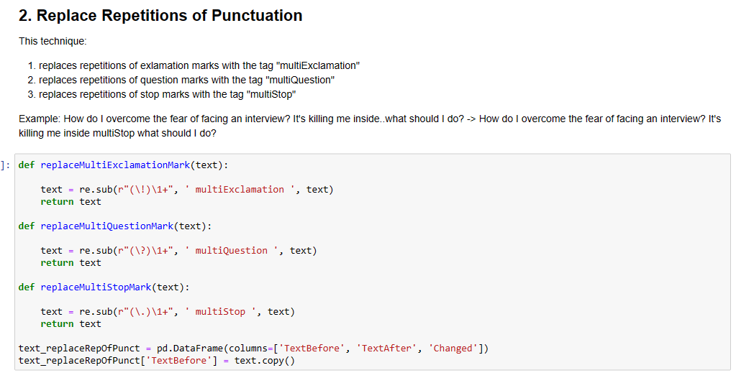
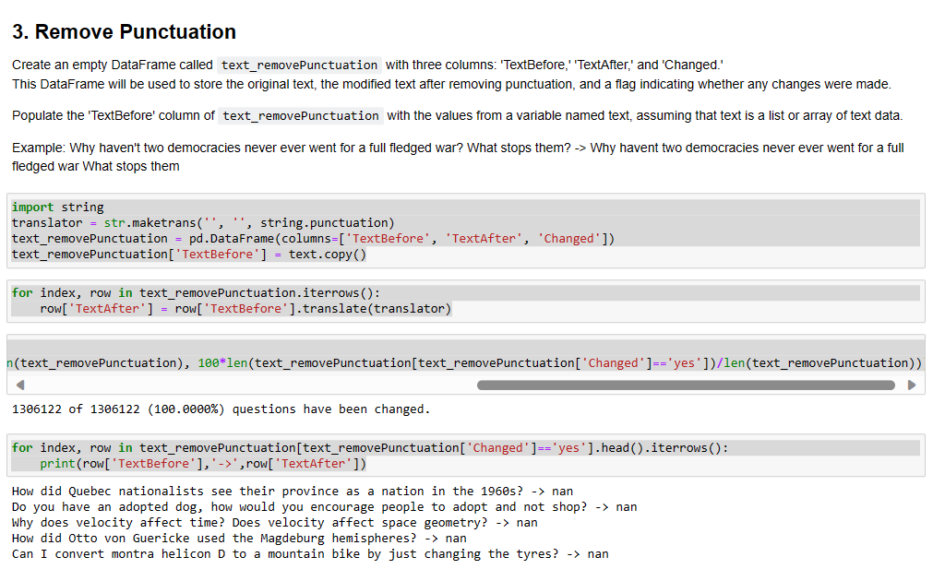
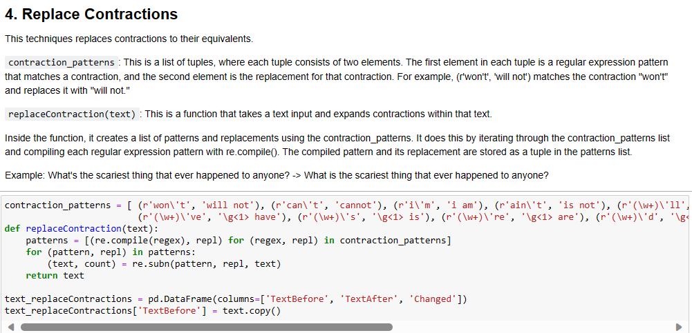
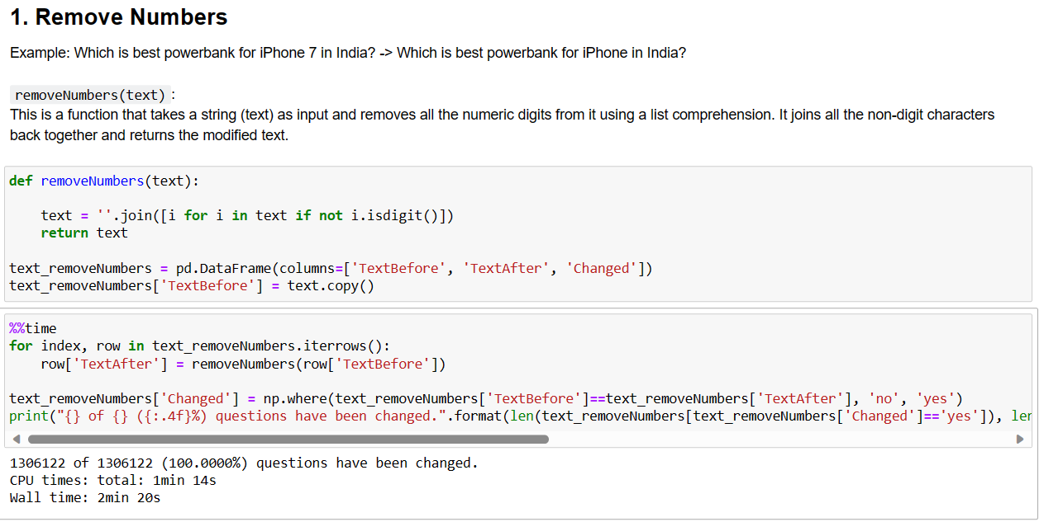
EDA and Feature Engineering

Slide 5
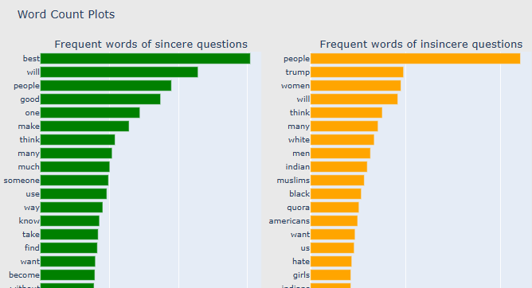
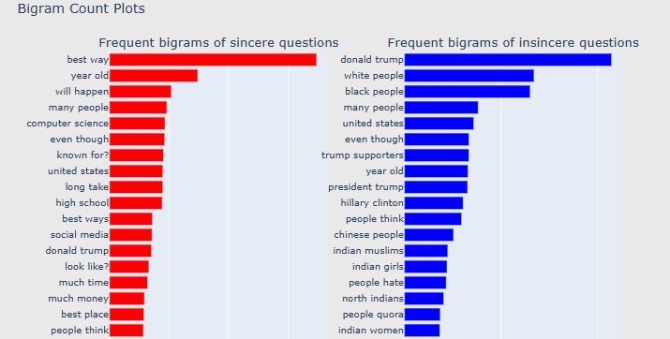
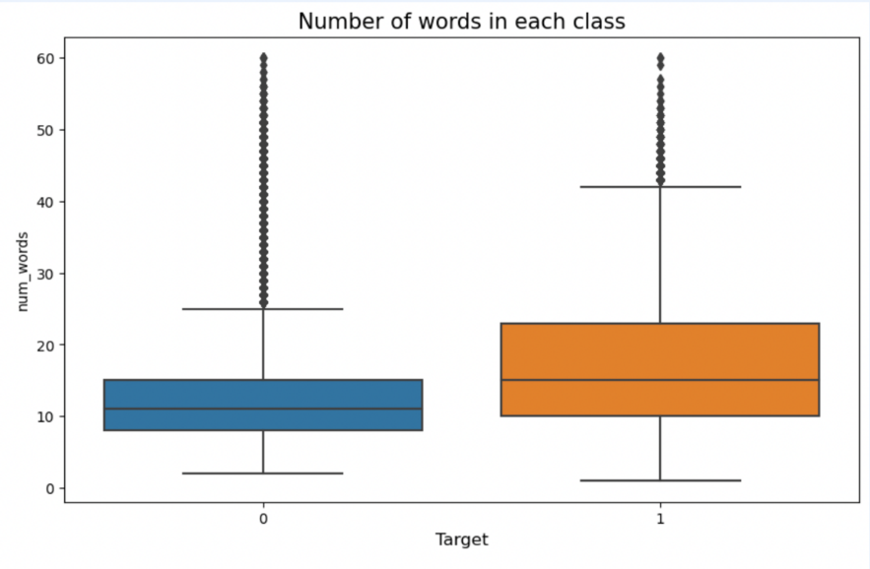
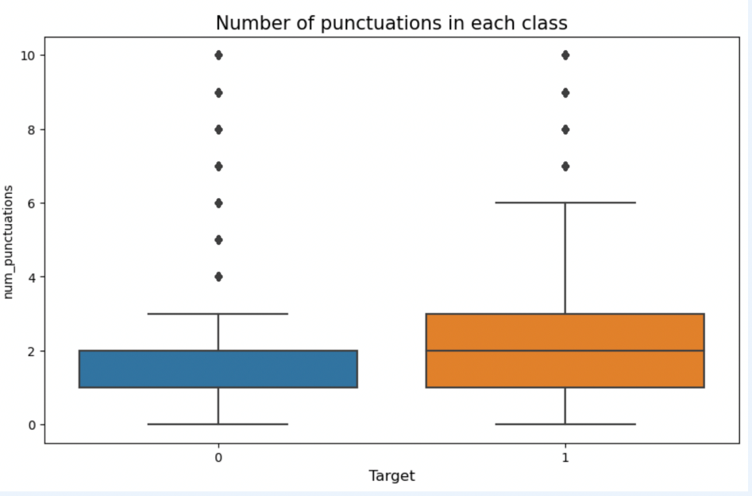
EDA and Feature Engineering

Slide 6
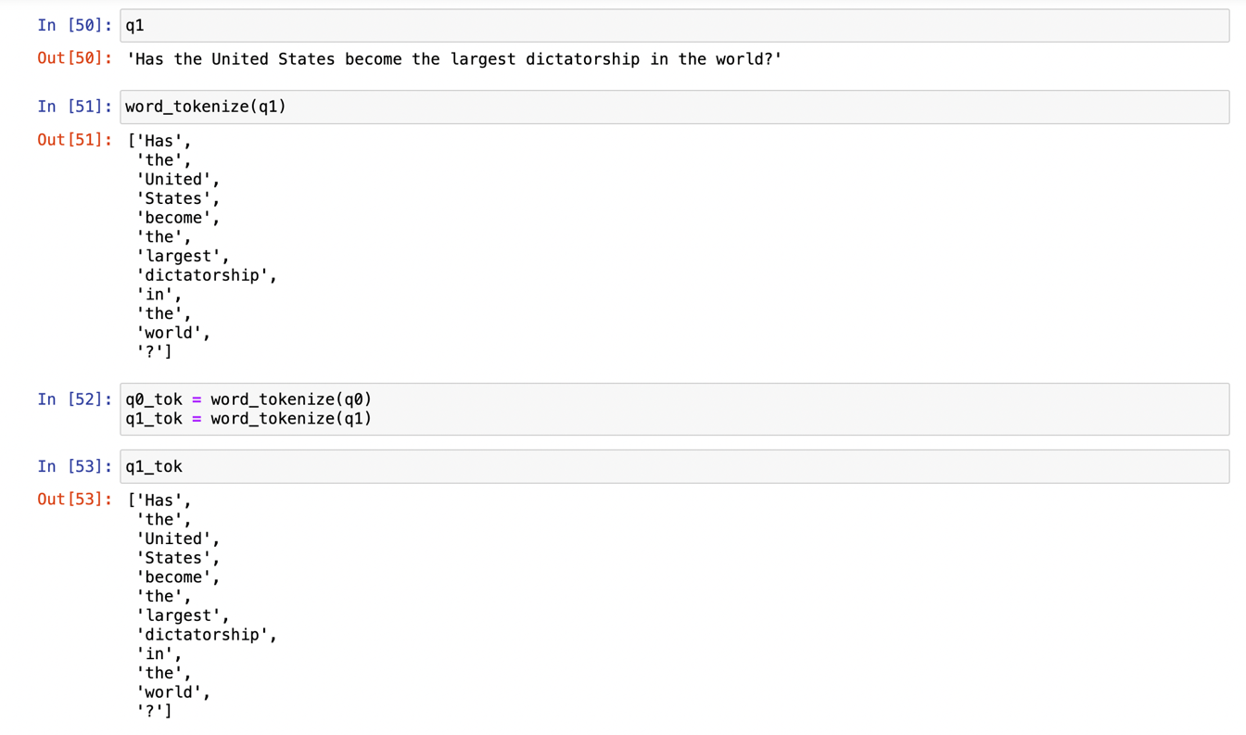
TEXT PREPROCESSING
TOKENIZATION
The code processes two sample questions, represented by the variables q0 and q1. These questions are part of a larger dataset.
The word_tokenize function from the nltk library is applied to each question. This function splits each question into individual words or tokens. For instance, the question "How are you today?" is tokenized into a list of words: ["How", "are", "you", "today", "?"].

Slide 7
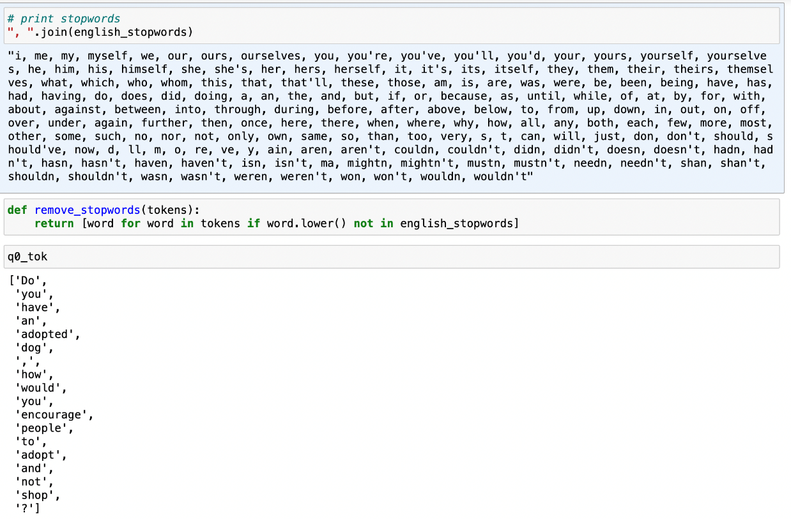
TEXT PREPROCESSING
STOPWORD REMOVAL
Tokenization:
Two example text strings, q0 and q1, are tokenized into lists of words using a tokenization process. Tokenization splits the text into individual words or tokens.
Stopword Removal:
The remove_stopwords function is applied to the tokenized lists, q0_tok and q1_tok. This function iterates through the tokens and removes any words that match the English stopwords list. It retains only the words that are not in the stopwords list.
Filtered Text:
The code stores the results in variables q0_stp and q1_stp. These variables now contain the text with stopwords removed. For example, if "are" and "you" were stopwords, the list ["How", "are", "you", "today", "?"] would become ["How", "today", "?"] after stopword removal.

Slide 8
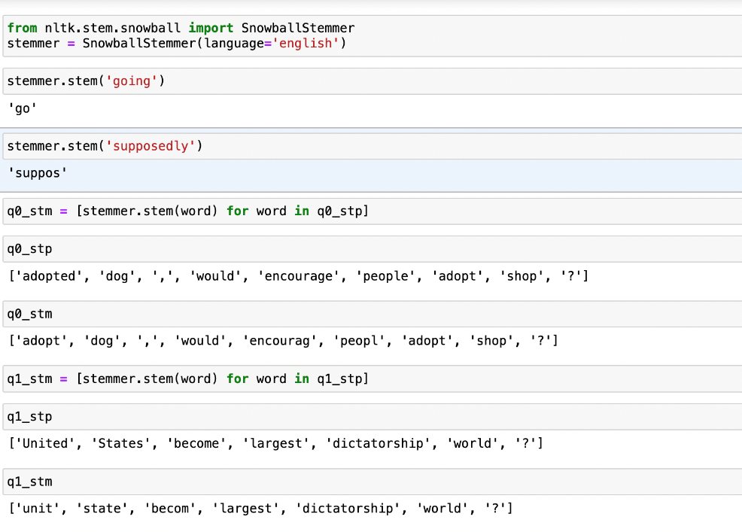
TEXT PREPROCESSING
STEMMING
Stemming is a common text preprocessing step in natural language processing (NLP) projects. Its primary goal is to reduce words to their root or base form. For example, it can transform variations of a word, such as "go," "gone," and "going," into the common root form, "go."
The stemming process iterates through each word in the lists and reduces them to their root forms, effectively simplifying the words.

Slide 9
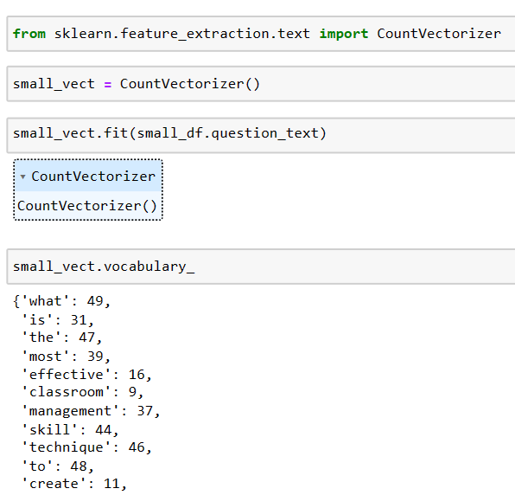
TEXT PREPROCESSING
4. IMPLEMENTING BAG OF WORDS COUNT VECTORIZER
Vocabulary Creation: Using the CountVectorizer from the scikit-learn library, we first establish a vocabulary. This vocabulary is a set of all unique words found in the dataset, excluding common English stopwords that add little meaning to the analysis.
Text Transformation: Each text entry is transformed into a numerical format. This is where the CountVectorizer comes into play, converting the text into a vector where each index corresponds to a word from our vocabulary, and the value is the frequency of that word in the text.
Text Preprocessing: Before transforming the text, we can configure the CountVectorizer to include text preprocessing to standardize the data. This might involve lowercasing the text, removing punctuation, and other similar tasks to ensure consistency.

Slide 10
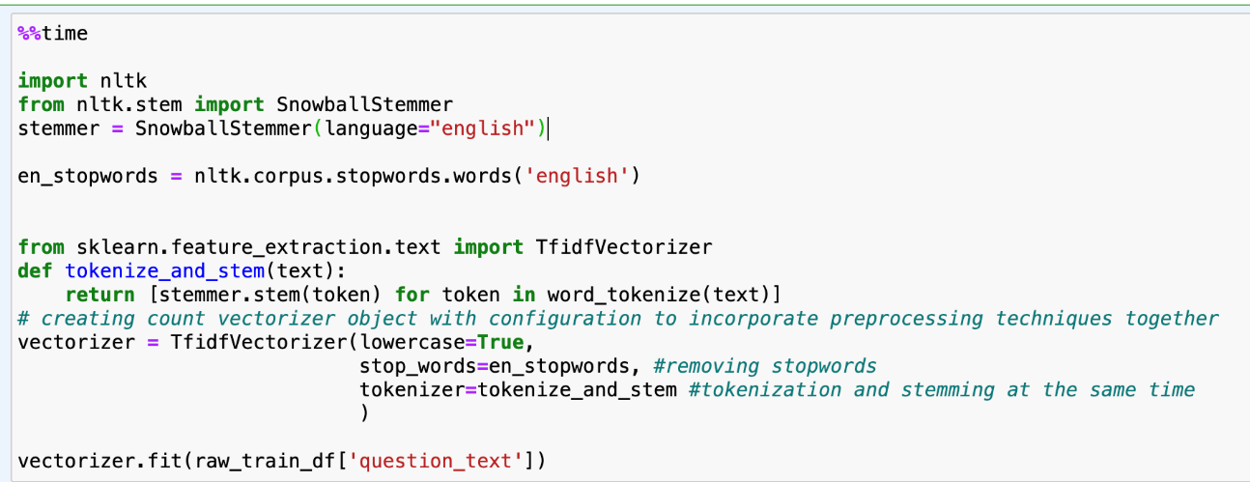
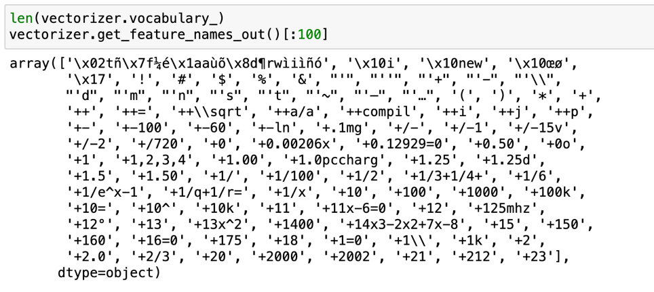
TEXT PREPROCESSING
TFIDF TOKENIZATION
TF-IDF, which stands for Term Frequency-Inverse Document Frequency. This method refines the process of turning text into numbers, enabling computers to understand and process language with a subtlety that goes beyond mere word counting.
The Custom Tokenizer: The function tokenize_and_stem(text) is crafted to tokenize and stem the given text. It combines text preprocessing steps like converting to lowercase, removing stopwords (common words that are typically excluded in text analysis), and stemming.
Vectorization: With TfidfVectorizer, we configure it to use our custom tokenizer function. Then, it is fit on our data, represented here as raw_train_df['question_text'], turning the text into a matrix.
Transformation: Finally, model_inputs is created by transforming our raw text data into the TF-IDF encoded format, ready for use in machine learning models.

Slide 11
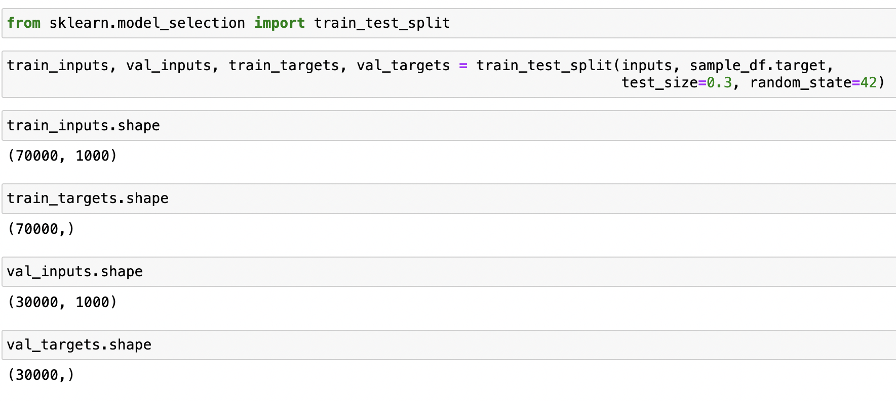
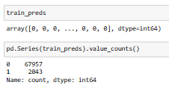
BASELINE MODEL IMPLEMENTATION
LOGISTICAL REGRESSION
Logistic Regression can efficiently handle such sparse matrices, making it suitable for text classification tasks.
Data Splitting: The journey begins with splitting the data into training and validation sets using train_test_split from sklearn.model_selection. This segregation is vital as it allows us to train the model on a subset of the data (70% in this case) and validate its performance on the remaining 30%.
Model Selection: LogisticRegression from sklearn.linear_model is the chosen model. It is capable of handling high-dimensional datasets, text data transformed into numerical vectors.
Configuring the Model: We specify MAX_ITER as 1000 and the solver as 'sag', standing for Stochastic Average Gradient descent, an optimization method well-suited for large datasets.
Training the Model: With model.fit(train_inputs, train_targets), the Logistic Regression model learns to associate the input features with the target classes.
Predictions: Using model.predict(train_inputs), we obtain predictions for the training set. These predictions can be compared with train_targets to evaluate how well the model is performing.

Slide 12
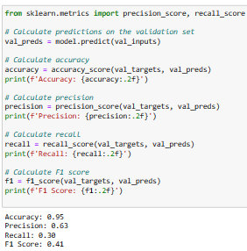
BASELINE MODEL IMPLEMENTATION
LOGISTICAL REGRESSION
With an Accuracy of 0.95, the model shows high-level correctness across all predictions.
Precision stands at 0.63, indicating that when the model predicts an insincere question,
it is correct around 63% of the time.
Recall hits at 0.30, suggesting that the model identifies 30% of all actual insincere questions.
Finally, the F1 Score of 0.41 indicates there is room for improvement, particularly in achieving a balance between Precision and Recall, which is vital for this dataset where both false positives and false negatives carry significant implications.

Slide 13
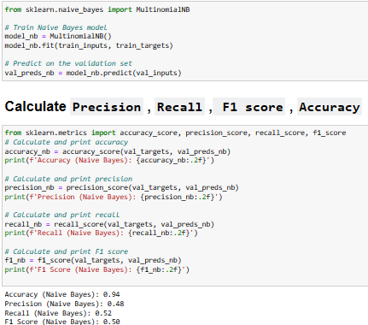
BASELINE MODEL IMPLEMENTATION
NAÏVE BAYES
Model Initialization: model_nb = MultinomialNB()
A Multinomial Naive Bayes model is instantiated, suitable for classification with discrete features (e.g., word counts for text classification).
Model Training: model_nb.fit(train_inputs, train_targets)
The model is trained using the training data, which consists of the inputs (train_inputs) and their corresponding targets (train_targets).
Prediction: val_preds = model_nb.predict(val_inputs)
Predictions are made on the validation set (val_inputs), where the model has not seen the data during training.
ERROR CALCULATION METRICS
Naive Bayes showed 94% accuracy, slightly lower than Logistic Regression's 95%, indicating a high rate of correct predictions across the dataset.
The Naive Bayes model has a precision of 48%, suggesting that when it predicts a question as insincere, the prediction is correct about half the time.
At 52%, the Naive Bayes model captures more than half of the actual insincere questions but still misses a significant portion.
An F1 score of 0.50 for Naive Bayes suggests a middle ground between precision and recall, reflecting a balanced trade-off, although not as strong as Logistic Regression in this case.

Slide 14
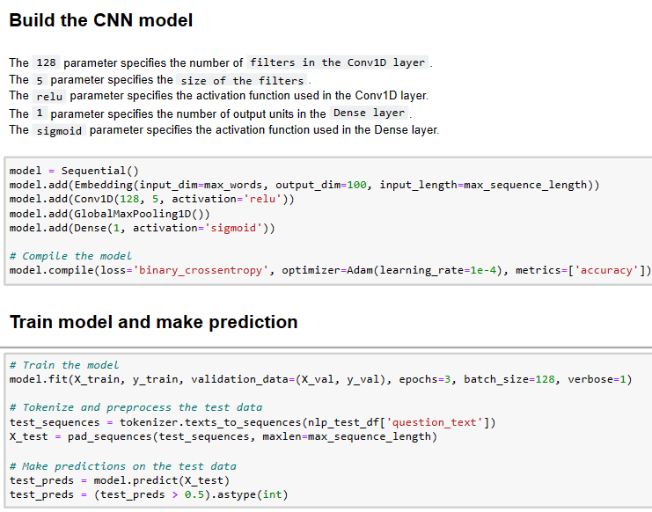
ADVANCE MODEL IMPLEMENTATION
CONVOLUTIONAL NEURAL NETWORK
Embedding Layer: Maps each word to a high-dimensional vector space and captures semantic meaning.
Convolutional Layer: Applies filters to the embedded vectors to extract local features.
Dense Layer: Fully connected layer that interprets the features extracted by the convolutional layers.
Tokenize & Preprocess: Text data is converted to lowercase, punctuation is removed, and words are stemmed. This standard preprocessing step ensures uniformity and reduces noise in the data.
Train/Test Split: The preprocessed dataset is divided into training test sets to enable evaluation.
Build the CNN Model: The Keras library is used to construct the CNN model, comprising an embedding layer, convolutional layers with ReLU activation, and a softmax layer for classification.

Slide 15
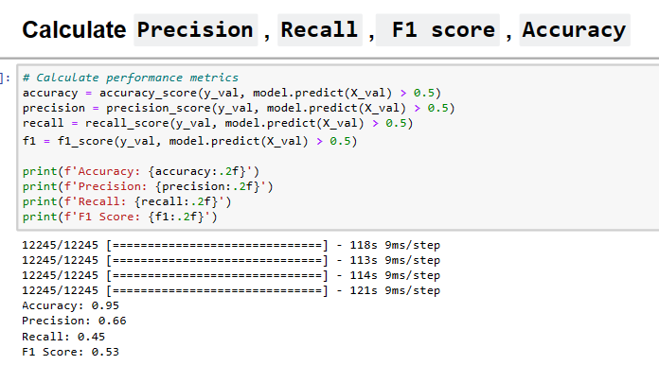
ADVANCE MODEL IMPLEMENTATION
CONVOLUTIONAL NEURAL NETWORK
An accuracy of 95% suggests that the model is making correct predictions for the vast majority of the data. This is a high level of overall correctness, indicating the model's ability to distinguish between sincere and insincere questions
A precision of 66% is a notable level of accuracy when it comes to predicting insincere questions. It implies that out of all the questions the model predicts as insincere, 66% are correct. This high precision is particularly valuable if you want to minimize false positives.
A recall of 45% indicates that the model is capturing almost half of the actual insincere questions. While not extremely high, it's still a respectable level of recall. This suggests that the model is effective at identifying insincere questions and minimizes false negatives.
F1 Score of 0.53 indicates that the model strikes a good balance between minimizing false positives and false negatives.
These metrics collectively suggest that your CNN model is performing well in classifying questions as sincere or insincere, and it's achieving a good trade-off between precision and recall.

Slide 16
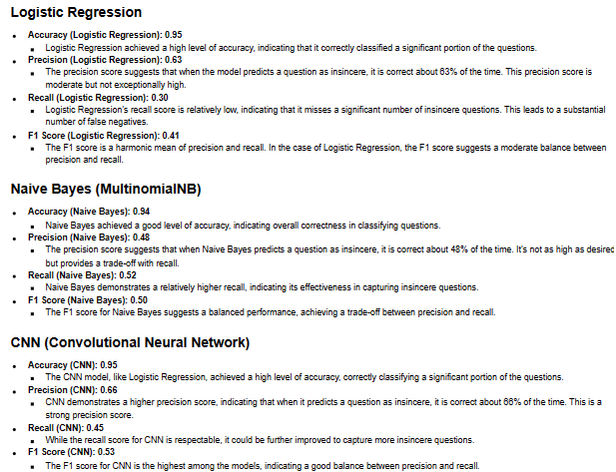
RESULTS
The evaluation of the three models suggests that CNNs provide a powerful mechanism for text classification, especially in identifying insincere questions in datasets like Quora's. Despite their computational cost, CNNs' ability to handle the intricacies of language makes them a strong candidate for complex NLP tasks.
Potential Improvements
Logistic Regression: Implementing advanced feature selection and regularization techniques can mitigate overfitting and improve model generalization.
Naive Bayes: Exploring feature engineering and alternative Naive Bayes variations could enhance its predictive capacity.
CNN: Integrating pre-trained word embeddings and expanding convolutional layers may increase the depth of text understanding.
CONCLUSION
Each model possesses unique characteristics that make it suitable for specific scenarios within text classification. Logistic Regression and Naive Bayes offer simplicity and computational efficiency, whereas CNNs excel in performance at the cost of complexity and computational demands. The choice of model should be influenced by the specific requirements of the task, data availability, and computational resources.
FACTORS
In applying these models, it is crucial to consider factors such as class imbalance, data preprocessing, and the trade-off between model interpretability and accuracy. Furthermore, the ever-evolving landscape of NLP suggests that continued research and experimentation with hybrid models and new architectures will be instrumental in advancing the field.

Slide 17
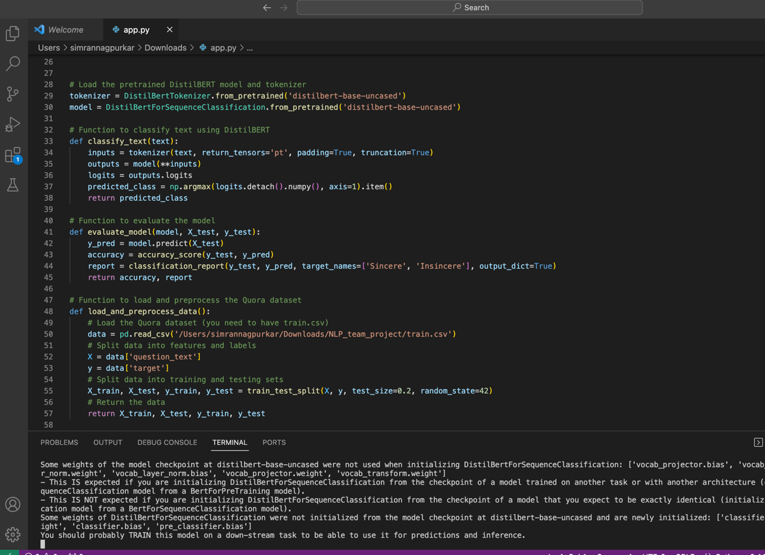
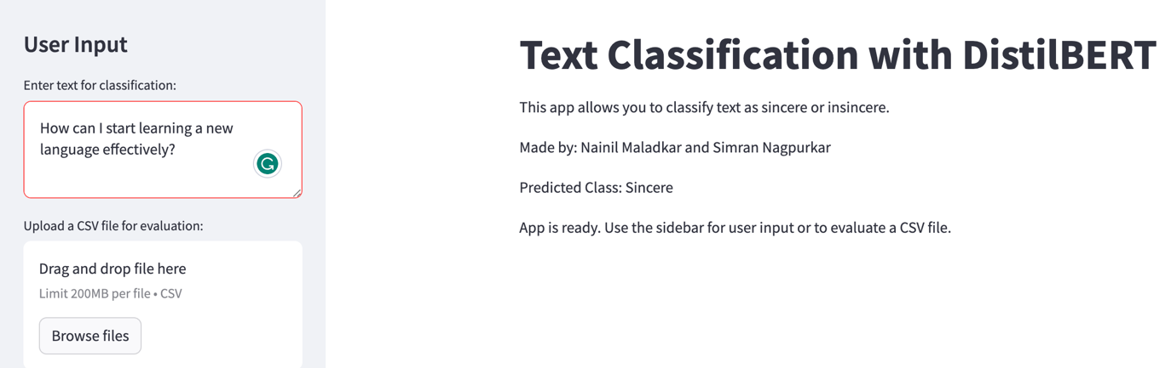
STREAMLIT APP with DistilBERT
BERT (Bidirectional Encoder Representations from Transformers)
One of the key strengths of BERT is its ability to understand context from both the left and right sides of a word. Traditional models like LSTMs and RNNs process text sequentially in one direction, which can limit their understanding of context. BERT, on the other hand, employs a bidirectional architecture that captures the full context of a word within a sentence.
BERT models are pretrained on large corpora of text data, which means they already have extensive knowledge about language and can be fine-tuned for specific NLP tasks. This pretraining allows BERT to learn rich and general-purpose representations of words and phrases, making it highly adaptable to a wide range of NLP applications.

Slide 18
REFERENCES
Majority of work has been divided among team members Nainil worked on the data preprocessing and EDA along with feature engineering For the text processing part, Nainil worked on TFIDF tokenization as an input to models.
Additionally, Model implementation including Naïve Bayes and CNN was carried out by Nainil Nainil bulit a framework to use DistilBERT for training of web model. Simran worked on some feature engineering and carried out text preprocessing using Bag of Words and implemented Stemming, stop word removal and vectorization. Logistical regression was also implemented to processed data. Simran made a streamlit application with input from user for interactive application for DistilBERT model.
1. NLP lecture python notebook by Prof. Junwei Huang
2. Medium blog on Quora Question Classification:
(https://medium.com/@amitbalharakr93/quora-insincere-question-classification-2f19a973273b)
3. Towards DataScience blog on Quora Question Classification
(https://towardsdatascience.com/quora-insincere-questions-classification-d5a655370c47)
4. Microsoft Bing AI chat
5. `Quora Insincere Questions Classification`
(https://www.kaggle.com/c/quora-insincere-questions-classification) Kaggle Dataset

